Slide 2
Children in the Philippines like to eat at McDonalds

Slide 3
At McDonalds, they might order rice or spaghetti

Slide 4
There are two seasons in the Philippines each year.

Slide 5
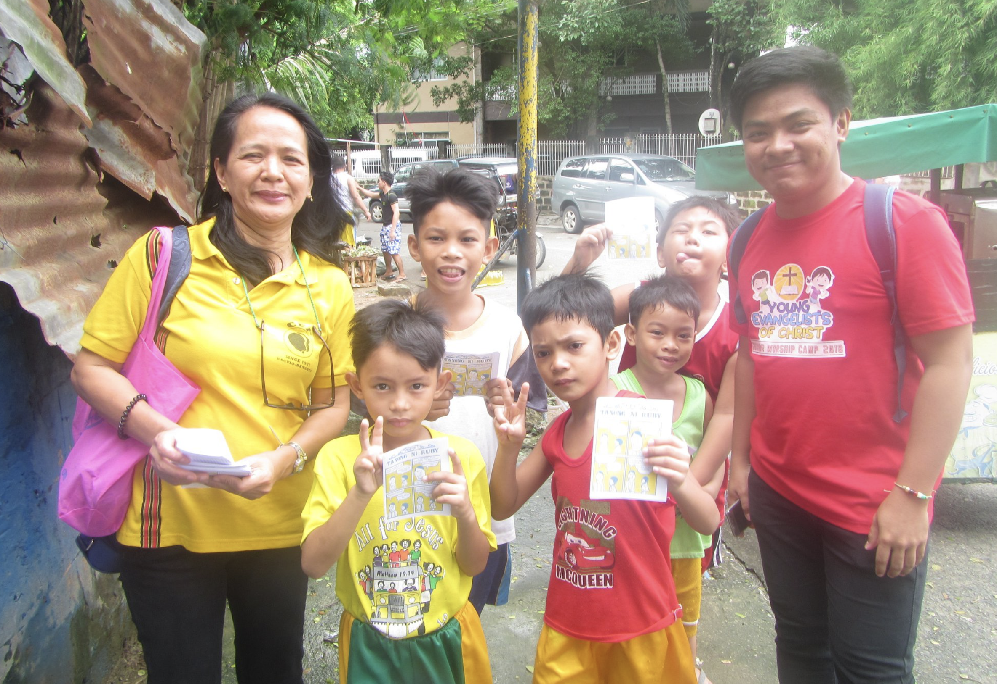
Almost all children in the Philippines speak two or more languages

Slide 6
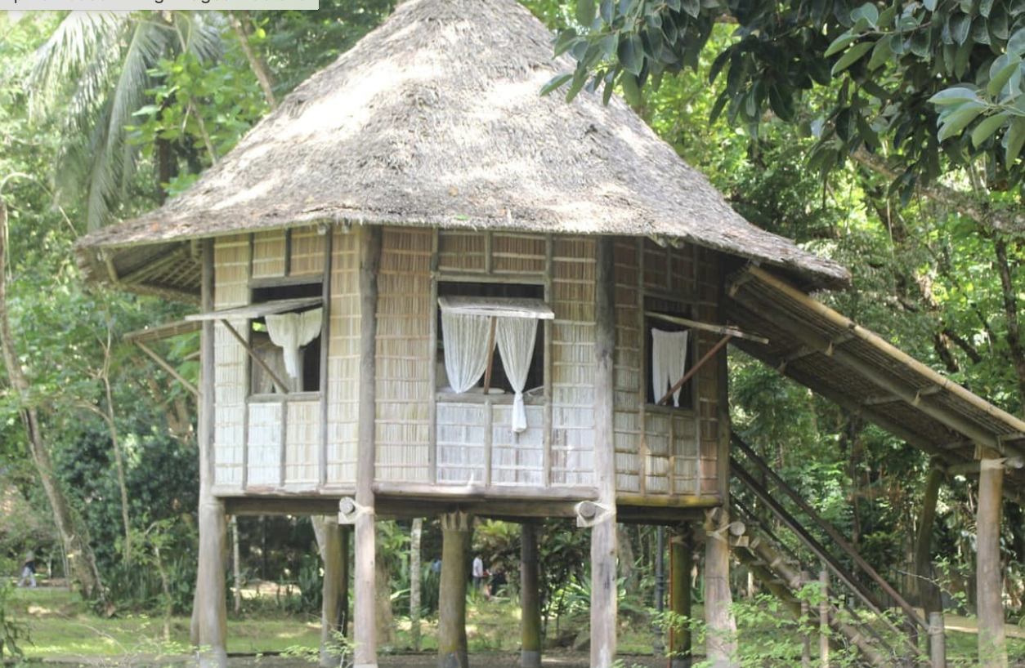
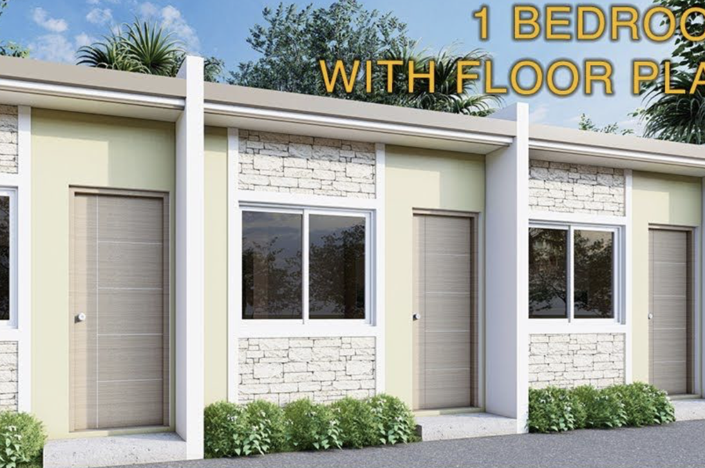
Many Filipino houses only have 1 or 2 rooms

Slide 7
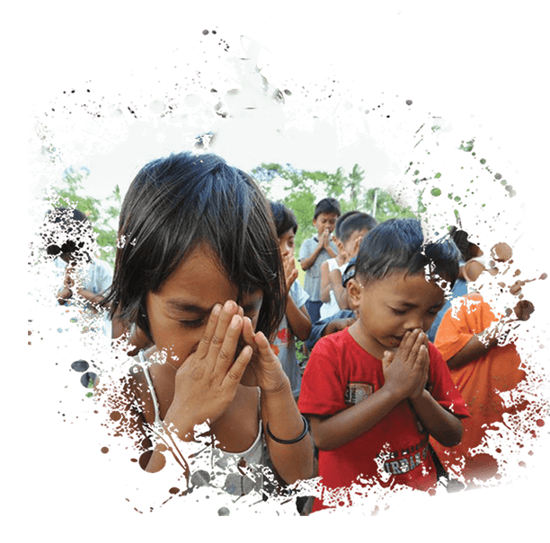
Children in the Philippines need to know that Jesus loves them and died for them

